Slide 1
How To Present Performance Results
Santhoshi Karri
Vijayakumar (Rittu) Rittambhra Rani
Carl Chang

Slide 2
Relationship between Latency and Throughput?
Latency and throughput work together to deliver high network connectivity and performance.
As both impact the transmission of data packets they also affect one another
“Many eggs can boil in parallel in a big pot, but a single egg still takes its full time”
How can you Improve Latency and Throughput?
To improve latency, by shorten the propagation between the source and destination, reducing processing delays and minimizing round trips.
To improve throughput, by increasing the overall network Bandwidth, adding parallelism, improving resource utilization and eliminating bottlenecks.
Some suggestions to improve latency and throughput together
Caching
Transport protocols
Quality of Service

Slide 3
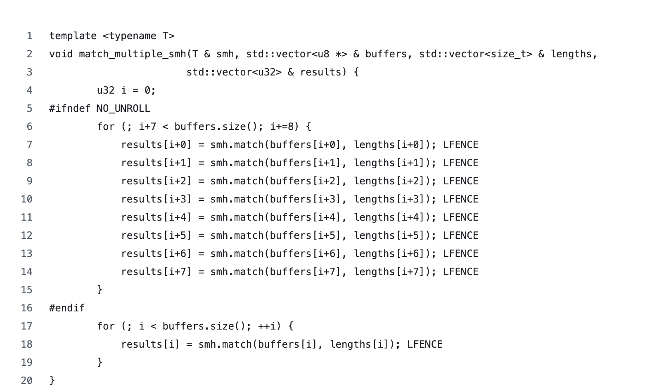
Measuring Throughput or Latency?
Each smh.match() call operates on different buffers, so the CPU can execute multiple operations simultaneously using out-of-order execution.

Slide 4
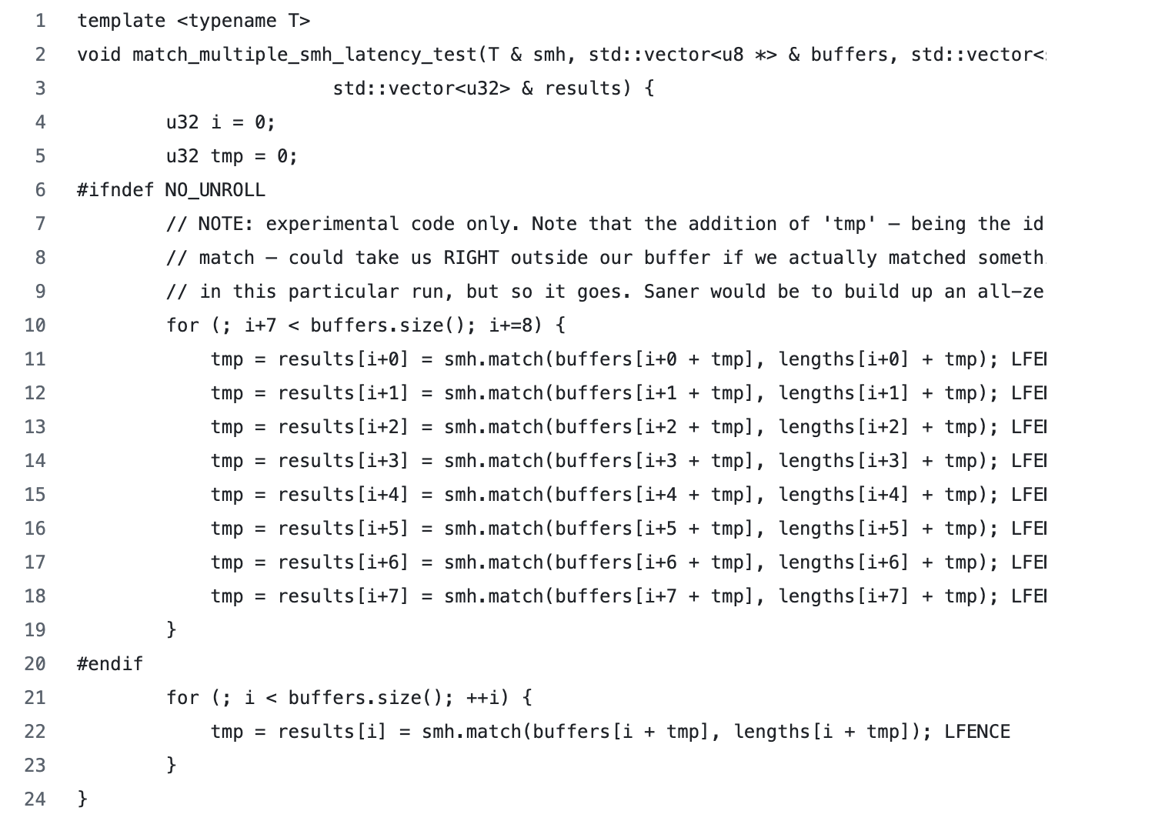
Measuring Throughput or Latency?
Each iteration uses tmp, which depends on the previous result, preventing instruction overlap.

Slide 5
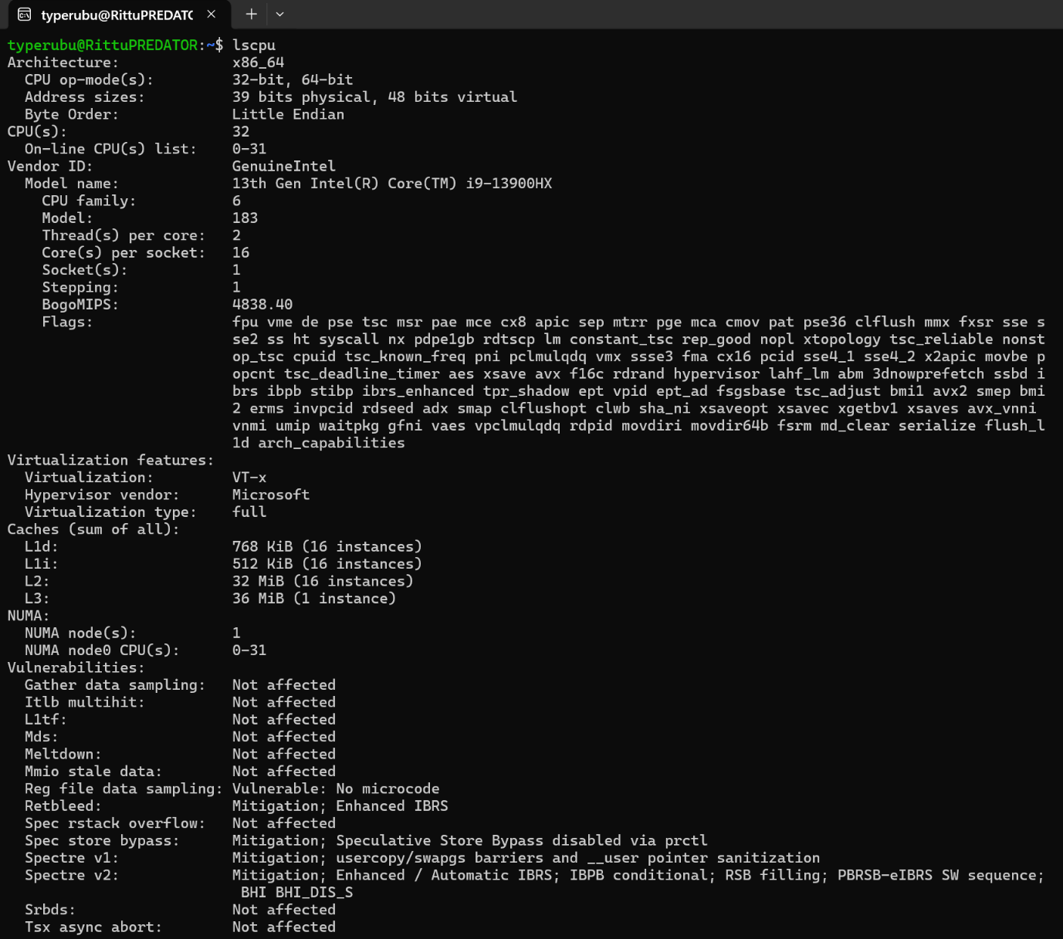
the benchmark env.
A NUMBER IS MEANINGLESS WITHOUT CONTEXT
Hardware Required:
Specific Microarchitecture (e.g., i9-12900K, not just "i7").
Memory Config (DDR5-4800).
Software Required:
Kernel Version (uname -r).
Compiler & Flags (gcc -O3 vs -O2).
System State:
Turbo Boost? (Frequency noise).
Background Daemons? (Dropbox, Chrome).
Notes:
"If you tell me your code runs in 5ms, that means nothing unless I know where it ran. Was it an i9 or an i3? Was Turbo Boost on? Was Chrome eating your RAM? You must document the environment, or the result is not reproducible." "When you say 'I have an i7', you aren't saying enough. Look at this lscpu output. This is the DNA of your computer. It tells us the L3 Cache size, the Architecture, and the Byte Order. If your L3 cache is 12MB and mine is 24MB, my code will run 2x faster than yours, even if our GHz is the same. Your report must include this data."

Slide 6
wall clock vs monotonic clock
wall clock ❌
time.time(), gettimeofday()
Purpose: Telling humans "It is 12:00 PM."
Mechanism: Syncs with the Internet (NTP).
Fatal Flaw: It can jump backwards.
Scenario: If your internal clock is fast (12:01) and the internet server says "No, it's 12:00," your OS resets the time back by one minute.
Result: Your benchmark duration becomes negative (-59 seconds). This destroys your data.
monotonic clock ✅
std::chrono::steady_clock, CLOCK_MONOTONIC.
Purpose: Measuring Intervals (Duration).
Mechanism: Counts hardware "ticks" from the moment the system boots up.
Guarantee: It never decreases, only goes up.
Resolution: Nanoseconds (vs Milliseconds for Wall Clock).
Notes:
Never use time.time(). It’s controlled by the internet. If the server updates the time while your benchmark is running, you could get a negative result. Always use steady_clock—it measures physics, not time of day
The Hook (The "Negative Time" Problem)
"Imagine you run a benchmark. You start the timer at 12:00:00. You finish at 12:00:01. The duration is 1 second. Simple, right?
Now imagine the operating system decides at that exact moment to sync with the internet. It realizes your clock is fast and sets it back to 11:59:59.
You finish the benchmark. End Time - Start Time = Negative 1 second.
This happens. It ruins experiments. And it happens because you used the Wall Clock."
2. The Solution (The Monotonic Clock)
"For science, we never use Wall Time. We use Monotonic Time.
Monotonic means 'always increasing.' It doesn't care what time it is in London. It just counts hardware ticks from the moment you turned the computer on.
It cannot jump back. It cannot be reset by the internet. It is the only valid way to measure software performance."
3. The Takeaway
"In Python, don't use time.time(). Use time.monotonic(). In C++, use std::chrono::steady_clock. If you see system_clock in your code, delete it."

Slide 7
Why measure performance and present results
Correctness is not enough. Being efficient is also important.
Performance depends on many external factors. Numbers are meaningless without context.
Runtime depends on many factors.

Slide 8
Hardware configuration
CPU: executes instructions like math operations, memory access, etc, basically controls everything
Clock speed: cycles per second, directly increasing code performance, e.g. 3 GHz CPU means 3 billion cycles per second, the more it has the less time it would take
Core number: really important for parallel program, divide works among cores, e.g. 8 cores means each does 1/8 of the total work
Cache: temporary storage for frequent access
RAM: slow memory, storage for program data, determines how much data and how many programs your computer can keep readily accessible for the CPU.
Key point: hardware determines performance capability

Slide 9
Software configuration
Compiler: converts code into machine instructions, managing things such as instructions, registers, loops, can be inefficient without proper optimizations such as remove unnecessary instructions, reduce memory access, uses less CPU cycles
Operating system: handles stuff like memory management, scheduling, thread, system call, different OS handle these differently
Libraries: libraries themselves provides optimized algorithms, different libraries worked differently, e.g. dynamic libraries, static libraries
Key point: software determines how efficiently hardware is used

Slide 10
System state
Would affect performance through a few ways
Background programs: the less the best
Cache interference: cache races, multiple processes compete for limited shared cache capacity, overwrite and reload of cache
System load causes inconsistent results: resource contention, forcing processes to wait for CPU time, if system load changes then available CPU change
Multiple runs is needed:dealing with noise sources such as OS scheduling, cache state, background activity

Slide 11
Key point: why they matter
Hardware configuration, software configuration and system state must be reported.
Hardware determines how fast instructions can execute.
Software determines how efficiently hardware is used.
System state affects measurement accuracy.
Without them, performance results might not be accurate enough and cannot be properly interpreted, which makes the comparisons unfair.

Slide 12
choosing the right mean (statistical competence)
Mean Type | Formula | When to Use | Example
Arithmetic | Sum / n | Pure Time or Latency | "Average Latency: 5ms"
Harmonic | n / Σ(1/x) | Rates (Speed, Throughput) | "Bandwidth: 100 MB/s"
Geometric | ^{n}√Πx | Ratios or Speedups | "System A is 1.5x faster"
Notes:
1. The Arithmetic Mean (The "Standard")
"Everyone knows the Arithmetic Mean. You add the numbers and divide by the count.
Rule: Use this only when measuring pure Time (seconds, milliseconds).
If you are measuring how long a task takes, this is correct."
2. The Harmonic Mean (The "Rate" Fix)
"But what if you are measuring Rates, like 'Megabytes per Second' or 'Frames per Second'?
A Rate is a fraction: work/time
If you use the Arithmetic Mean on rates, you get the wrong answer. You bias the result toward the high outliers.
Rule: For any rate (MB/s, MIPS, FPS), you must use the Harmonic Mean. It handles the fractions correctly."
3. The Geometric Mean (The "Ratio" Fix)
"Finally, what if you are normalizing data? Like saying 'System A is 1.5x faster than System B'?
These are Ratios, not raw numbers.
Rule: For speedups and unitless ratios, use the Geometric Mean. This ensures the math works regardless of which system is the baseline."
Interactive "Pop Quiz" (To Wake Them Up)
This is the best way to prove why Harmonic Mean matters.
The Setup:
"Let's do a quick mental math check.
I drive to the store at 10 mph.
I drive back home at 100 mph.
The distance is the same.
What is my average speed?"
The Trap:
Most people will say 55 mph ($10 + 100 / 2$).
The Reality: It is actually ~18 mph.
Why? Because you spent 10x more time driving slow (10mph) than you did driving fast.
The Harmonic Mean correctly calculates this as 18 mph. The Arithmetic Mean (55) is a lie.
The Conclusion:
"If you used the Arithmetic Mean for your network throughput, you would lie to your boss just like you lied about the car speed. Use the Harmonic Mean for rates."

Slide 13
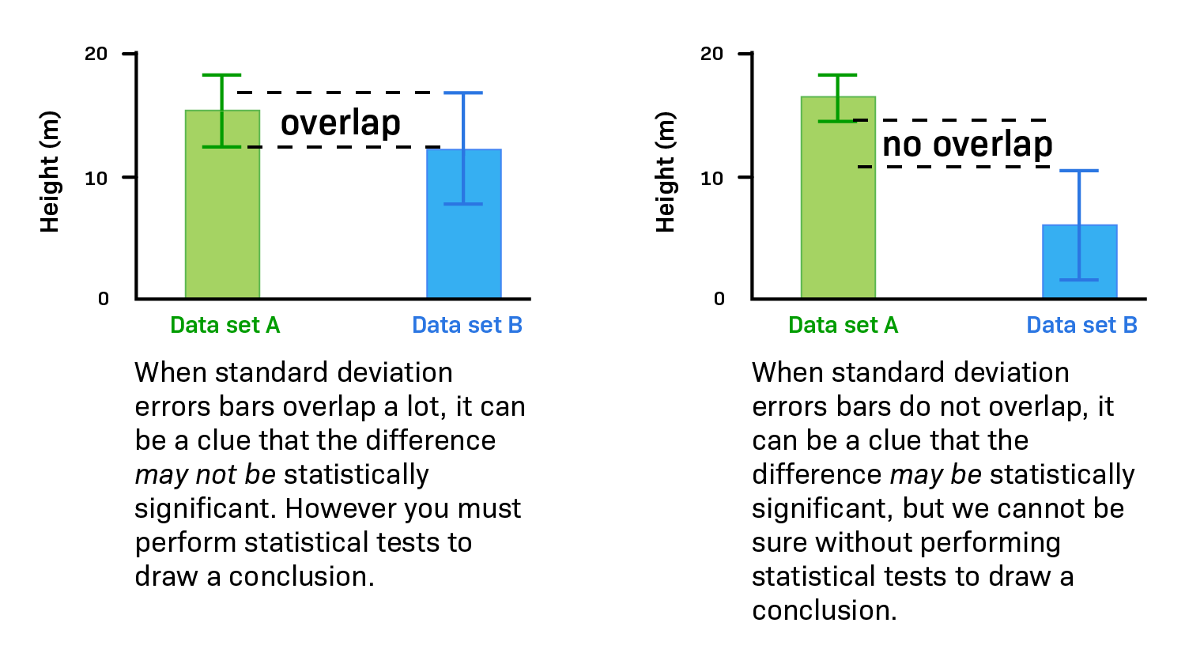
the “overlap” rule: confidence intervals
illusion: A single number implies 100% certainty.
reality: Every system has noise.
requirement: Always plot 95% Confidence Intervals (Error Bars).
Rule of thumb:
If bars Overlap → Statistically Indistinguishable (Tie).
If bars Separate → Valid Win.

Slide 14
Flame Graphs - https://www.brendangregg.com/flamegraphs.html
Why do we need Flame Graph?
Where is CPU time going?
Which function is taking the most time?
What part of the code should we optimize?
Flame Graph
A flame graph is a visualization of many stack traces aggregated together. It was originally used to show what is “hot” on-CPU.
Each box represents a function in the program.
The width of a box shows how much time was spent there.
The vertical direction shows the call stack (who called whom).

Slide 15
How to make flame graph (terminal commands)
Do this step by step:
(Skip the following line if on sunlab)
sudo apt install linux-tools-common linux-tools-generic linux-tools-$(uname -r)
git clone https://github.com/brendangregg/FlameGraph.git
g++ -O2 -g your_program.cpp -o program
perf record -F 99 -g ./your_program (this would output perf.data)
perf script > out.perf
./FlameGraph/stackcollapse-perf.pl out.perf > out.folded
./FlameGraph/flamegraph.pl out.folded > flamegraph.svg
lastly download flamegraph.svg or use firefox flamegraph.svg if you have firefox

Slide 16
Day 2

Slide 17
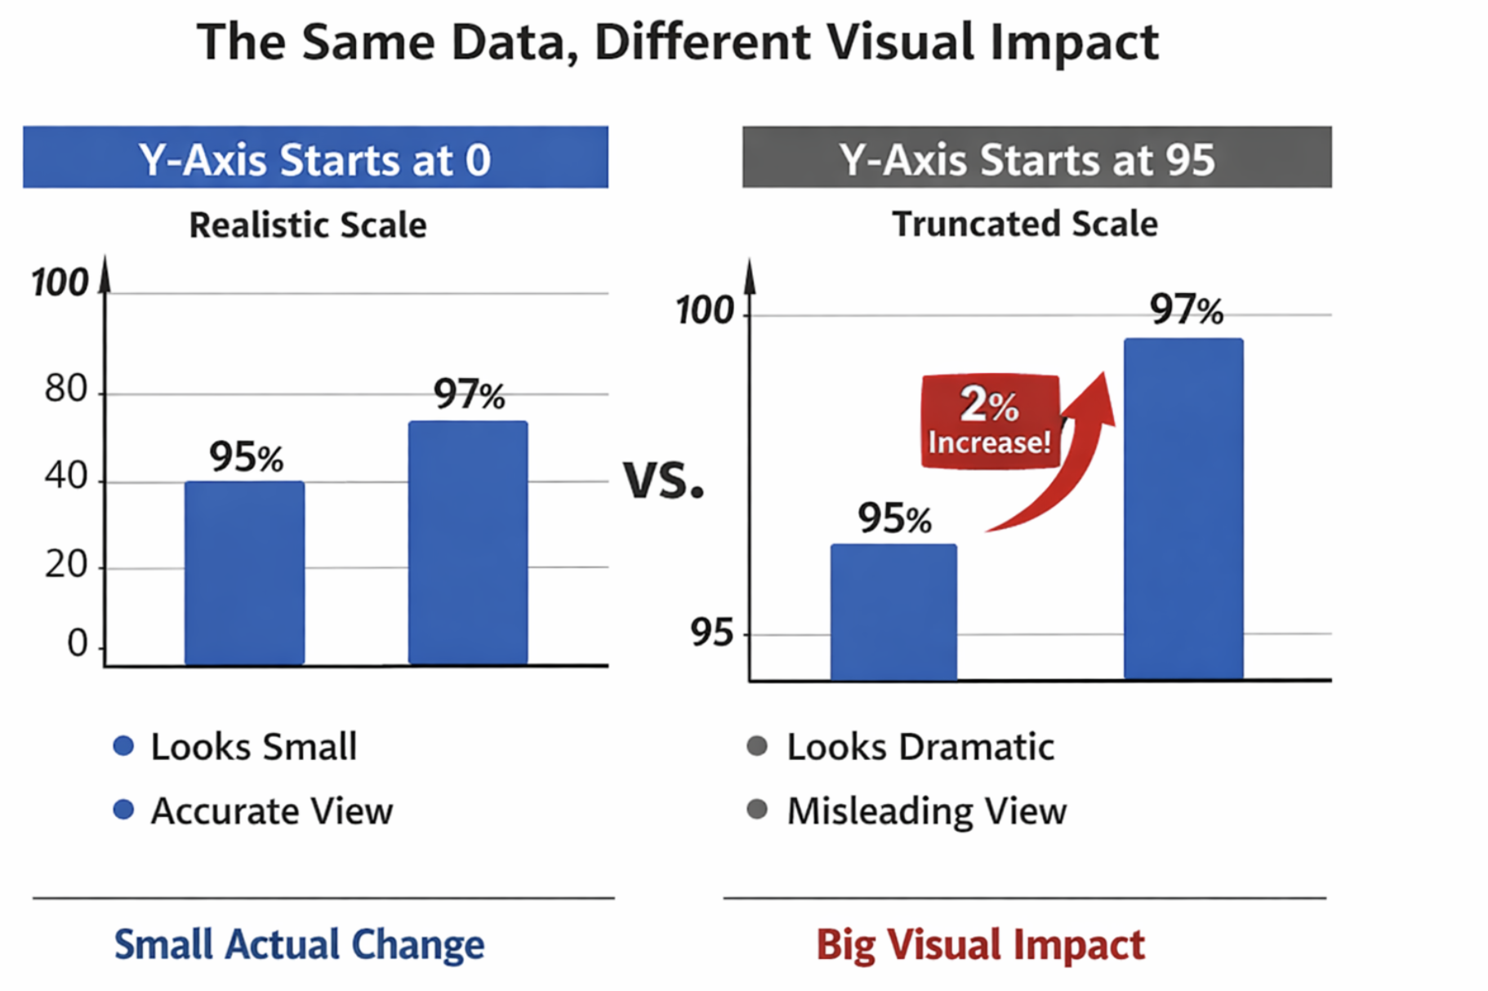
How to Measure, Present, and compare parallel performance
This paper addresses problems in the presentation of parallel performance.
Presentations often:
Exaggerate or diminish performance differences
Conceal important Performance trends
Ignore significant computational costs
Introduce distortion unintentionally
Goal:
Present information
Use Space/time effectively
Minimize distortion

Slide 18
Measure Elapsed Time
Single process CPU time may be misleading.
CPU time measures only active computation
Elapsed time measures total time to solution
Elapsed time includes:
Computation
Lock waiting
Synchronization
Cache coherence overhead
Paging and I/O
Operating system scheduling
Parallel execution time is not deterministic.
Measure multiple runs
Report mean and variance
High Variance may indicate contention
Then:
Cache Measurement strategies:
Measure Stable cache behavior
Measure transient Caches
Present Elapsed Time
Present elapsed time.
Avoid presenting speedup where possible because:
Speedup is a derivative measure
It depends on the chosen sequential baseline
Different derivations can lead to different conclusions
Present elapsed time directly to avoid undocumented derivations.
Compare
Parallel performance depends on many independent variables.
Algorithms
Parallelization
Programming System
Machine architecture
Problem Size
Number of processors
To avoid distortion:
Change as few independent variables as possible
Document all changes clearly
Compare systems under controlled conditions

Slide 19
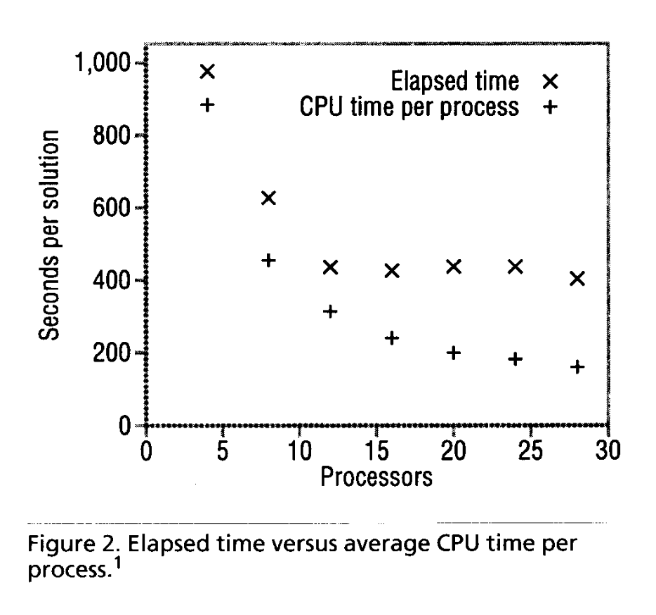
CPU Time vs Elapsed Time
CPU time and elapsed time behave differently in parallel systems.
CPU time often decreases smoothly with processors.
Elapsed time behaves differently.
Parallel coordination overhead includes:
Lock contention
Synchronization barriers
Cache Coherence Traffic
Paging delays
OS scheduling
Elapsed time reflects true system-level performance

Slide 20
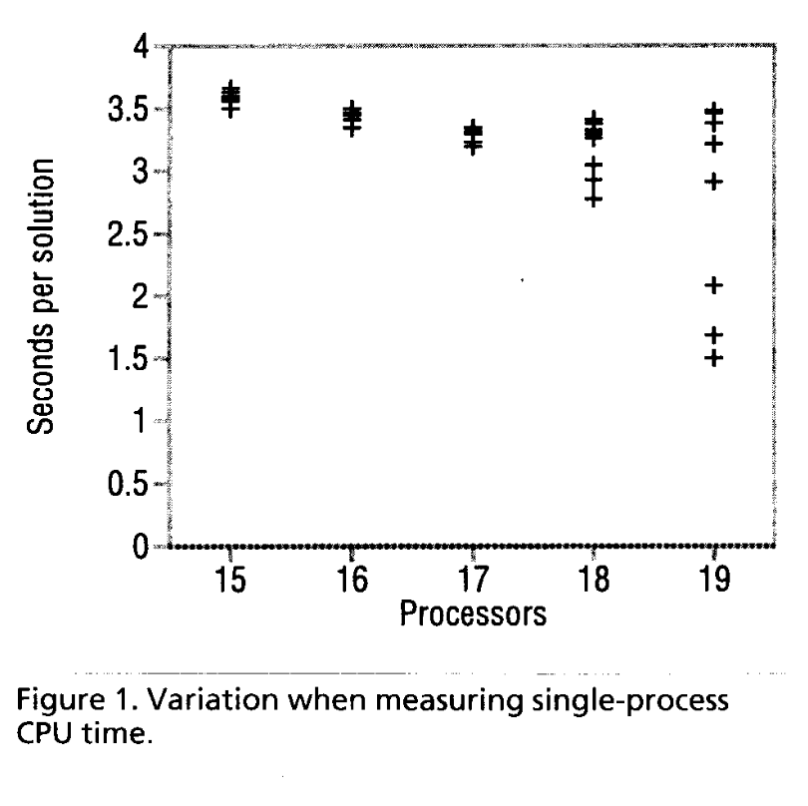
Variance Predicts Scalability Instability
Growing variance signals:
Contention amplification
Synchronization pressure
Resource interference
Lock convoying
Then:
Execution time variance must be reported.
High Variance may indicate structural scalability problems

Slide 21
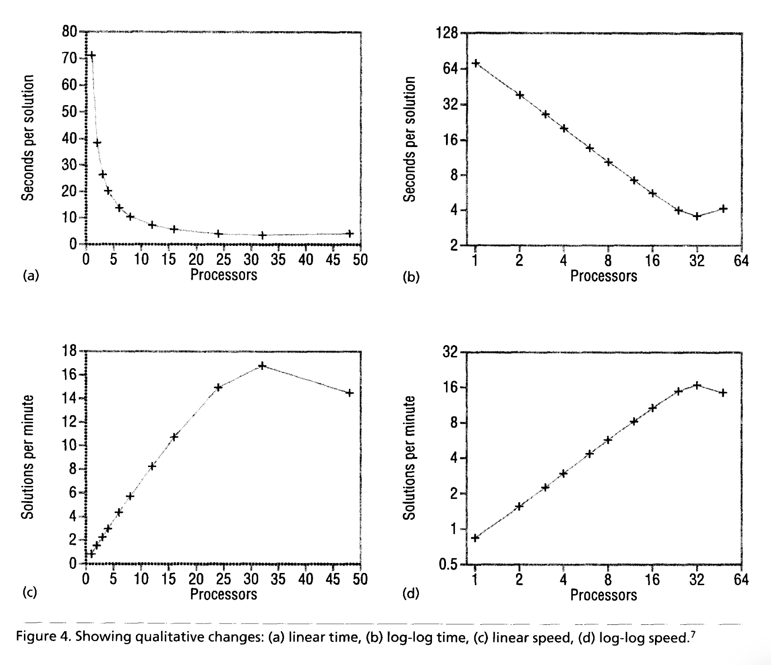
Log-Log Time Reveals True Scaling Geometry

Slide 22
Linear time plots:
Hide qualitative changes
Compress high processor counts
Make linear scaling appear nonlinear
Log-Log time plots:
Make linear performance appear linear
Reveal qualitative changes
Preserve Relative performance
Scale Invariant
Use log-log time plots when absolute performance is not the primary concern.

Slide 23
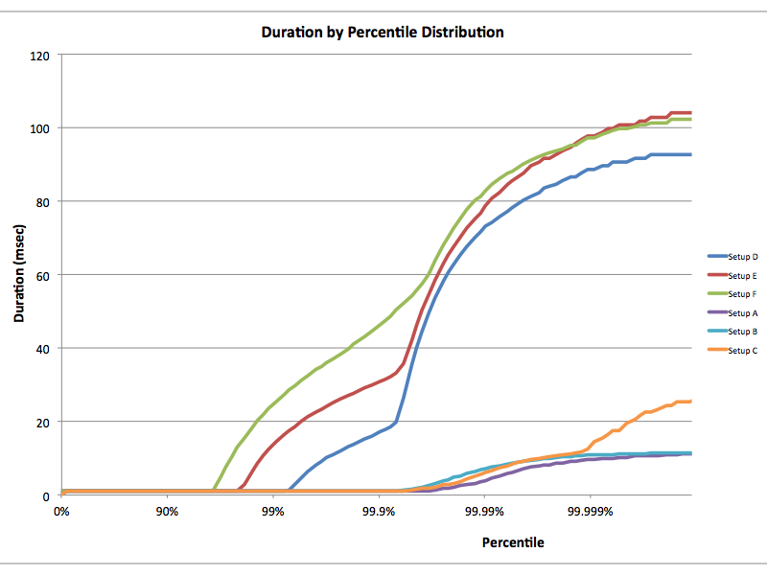
benchmarking crime #1 - Gil Tene’s coordinated omission
illusion (Blue Line): Standard "Closed Loop" tools (e.g., ab, JMeter) report low latency even at high percentiles because they pause during server stalls.
reality (Red Line): "Open Loop" testing corrects this by measuring the actual wait time during stalls.
delta: The massive gap between the curves represents Survivor Bias: data points that were "omitted" because the benchmark tool was waiting for a response.
fix: Never trust high-percentile latency (p99, p99.9) from a closed-loop generator.
Corrected for coordinated omission
Uncorrected omission
Notes:
Let's talk about the single biggest statistical lie in systems engineering: Coordinated Omission.
Look at this graph.
The Blue Line is what standard tools like ApacheBench report. It looks amazing. It stays flat and low all the way to the 99.99th percentile. It tells you the system is perfect.
The Red Line is the exact same system measured correctly.
Why the difference? Standard tools are Closed Loop. If the server freezes for 10 seconds (e.g., a Garbage Collection pause), the benchmark tool waits. It stops measuring. It effectively 'omits' the 10-second failure from the dataset.
The Red Line accounts for that stall. It shows that the 99th percentile latency is actually massive.
The Takeaway: The Blue line is 'Survivor Bias'—it only measured the happy paths. If you publish the Blue line in a paper, your results are invalid."

Slide 24
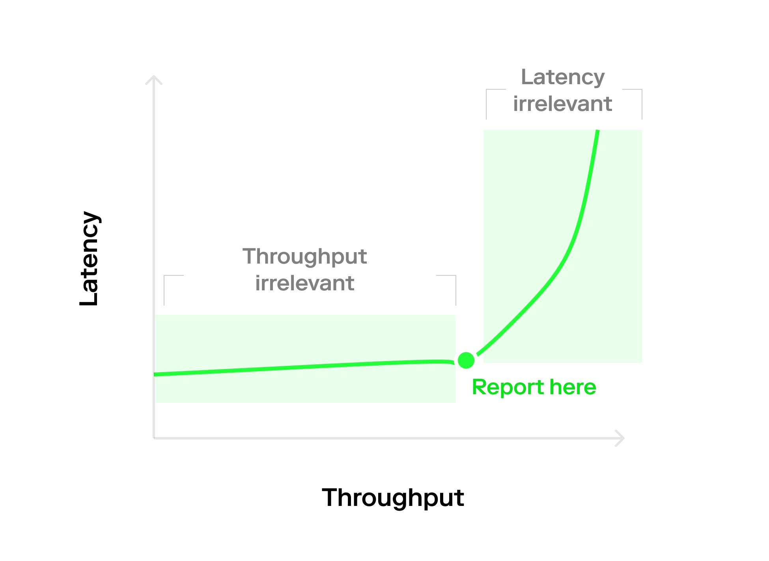
benchmarking crime #2 - "zero-cost" throughput
decoupling fallacy: Reporting "Max Throughput" and "Min Latency" as independent metrics
physics: Little’s Law (L=λW) dictates that as utilization approaches 100%, queue lengths (and latency) approach infinity
saturation point: High throughput is often achieved by buffering, which inherently destroys latency
fix: Never report single numbers. We plot the Saturation Curve to identify the "Knee", which is the precise load where latency degrades non-linearly
Notes:
The second crime is treating Throughput and Latency as if they are separate variables. They are not. They are enemies.
Look at this curve. On the left, latency is low, but throughput is boring. On the right, throughput is high, but latency is infinite (the system is crashing).
If you read a paper that says, 'We achieved 1 million ops/sec' and '1ms latency' in separate paragraphs, they are likely lying. They achieved the 1 million ops at the top of this curve (where latency is terrible), and the 1ms latency at the bottom (where throughput is tiny).
To be rigorous, you must plot this Saturation Curve. You need to show us exactly where the 'Knee' is—the point labeled 'Report Here.' That is the only honest measurement of a system's capacity."

Slide 25
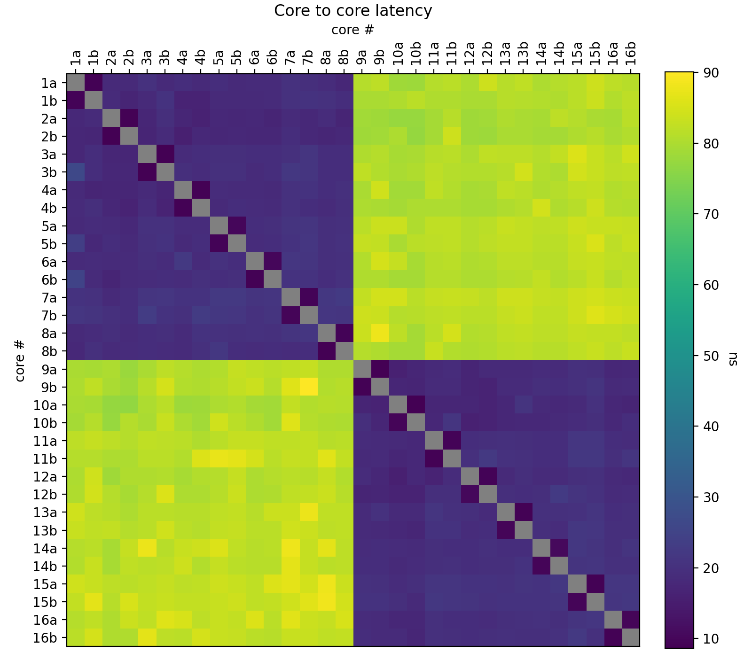
L3 Cache Domain (CCX)
Interconnect Penalty
failure of linearity: High-dimensional data (e.g., N * N core interactions) cannot be flattened into line plots without losing topological context.
"block diagonal" structure:
Small Blocks (2 * 2): Reveal SMT (Hyperthreading) siblings sharing L1/L2 cache.
Large Blocks (4 *4): Reveal CCX (Core Complex) boundaries sharing L3 cache.
"off-diagonal" penalty: Yellow zones represent the latency cost of crossing the infinity fabric or Interconnect.
This data dictates thread affinity (sched_setaffinity). We pin communicating threads within the same "Purple Block" to avoid the "Yellow" latency penalty.
https://github.com/andportnoy/core-to-core-latency
Notes:
"Now, let's talk about visualizing topology.
If you plot 64 cores on a line graph, you get spaghetti. You lose the spatial relationship between them.
To understand hardware, we need a Heat Map.
Look at this matrix. This isn't just a chart; it is a Physical Map of the Silicon.
The Diagonal: This is Core $N$ talking to itself. Zero latency.
The Small Purple Squares: These are SMT siblings—two threads on the same physical core. They share L1 and L2 cache, so communication is instant.
The Large Purple Blocks: This is the CCX (Core Complex). All these cores share a unified L3 cache. They can talk to each other fast.
Now look at the Yellow Zones.
This is the Interconnect Penalty. This happens when a thread in Core Block A tries to talk to Core Block B. The data has to physically leave the die and travel across the Infinity Fabric.
The Takeaway: If you let the OS schedule your threads randomly, it might put a producer on Core 0 and a consumer on Core 16—right in the yellow zone. You just accepted a 3x latency penalty for no reason.
Systems engineers use this map to write Thread Affinity policies, pinning threads to the same L3 domain to stay in the purple."

